Slide 1

External Project Presentation of Computer Networking(CSE 3034) on PEER-to-PEER(P2P) Distributed File Sharing System
Presented by
Amit Aryan (2141001065)
Pragyananda Behera
(2141002050)
Apoorva (2141001060)
Anandita Bharati (2141002085)
Subham Bindhani (2141002151)
Supervisor
Mr. Ashutosh Chakraborty
&
Mr. Dipnarayan Das
Department of Computer Science and Engineering
Institute of Technical Education & Research (FET)
Siksha ‘O’ Anusandhan Deemed to be University, Bhubaneswar
Jan, 2024

Slide 2
Contents
Introduction
Problem statement
Methodology
Implementation
Result and Interpretation
Conclusion

Slide 3
Introduction
Peer to Peer technology is the one which is used for sharing the data between two computers or more computers without the need of server. In this kind of network one of the peer acts as server and other peer acts a client. In this Project we have made use of Java IO and Thread and Java Remote Method Invocation (RMI) which is a built-in framework.
Features:
1) Peer Discovery
2) File Transfer
3)Concurrency
4)File Management

Slide 4
Problem Statement
The goal of this project is to create a peer-to-peer (P2P) Distributed File Sharing System allowing users to share and download files directly from each other's machines without relying on a central server. The system should provide mechanisms for peer discovery, file transfer, concurrency management, and file management through a user-friendly console interface.
User Interaction: Users will interact with the system through the console, where they can initiate file uploads, search for and download files from other peers, and manage their own shared files. The system will reflect the results of these interactions in the console, providing feedback on successful transfers and file management operations.
Resource Utilization: Efficient use of system resources, especially during concurrent file transfers, is crucial to avoid performance issues and ensure a seamless user experience. By addressing these features and constraints, the P2P Distributed File Sharing System aims to provide users with a decentralized and efficient way to share and download files directly from their peers .

Slide 5
Methodology
In this program using Java thread and IO and RMI, there are three main parts:
1. Client: Used to access remote methods on a server.
2. Object Registry: Created by the server to register remote objects. The server first creates a registry on a specific port.
3. Server: Implements the remote methods declared in the remote interface.

Slide 6
Implementation
Source Code and Program list
1)ServerInterface.java: here three functions are declared i.e.
(i) Register(String peer_id,String File_Name,String Port_No,String Src_Dir)
(ii) Search(String File_Name)
(iii) DeRegister(String peer_id,String File_Name,String Port_No,String Src_Dir)
2) ServerImpl.java:Here I have implemented all the functions declared in ServerInterface.java
3) Server.java: This is the one which contains the main function, and we just need to run this to start the server.
4) FileDetails.java: I have created this just to get new data type ,when we create an object of this class then it contains all the file details like PeerID,fileName,portNo,sourceDir.
5) Client.java: This is the one which has the main function and since there is only one function for client. The function implemented here is “dwnldFrmPeer(String pp, ArrayList<FileDetails> ar)”.
6) ClientInterface.java and ClientImpl.java: I have created these two for future purposes so that I can move the dwnldFrmPeer(String pp, ArrayList<FileDetails> ar) function to ClientImpl.java.
7) Concurrent.java: This is the independent file which you can run after running Server. java and then register PEER4 and register file 100.txt with the server.

Slide 7
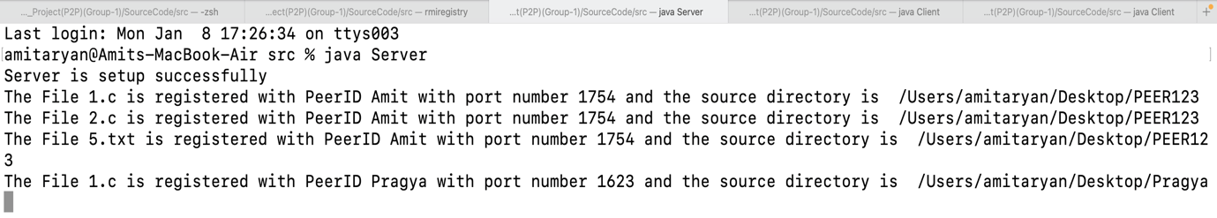
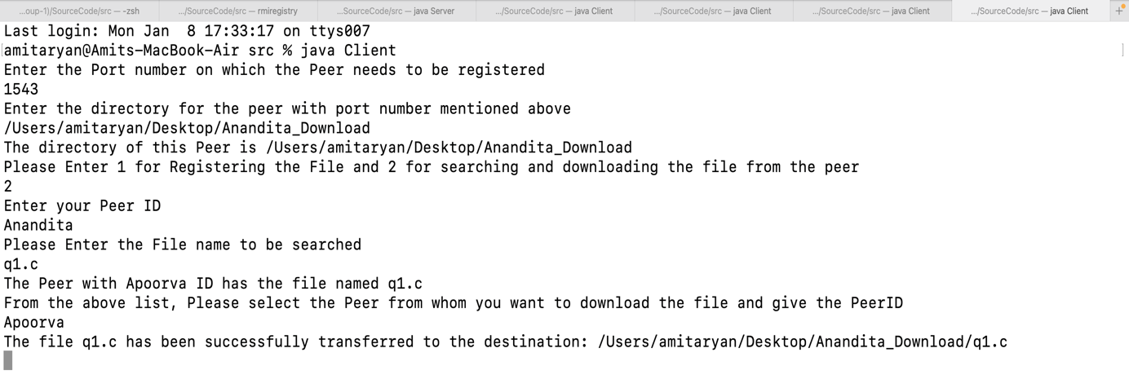
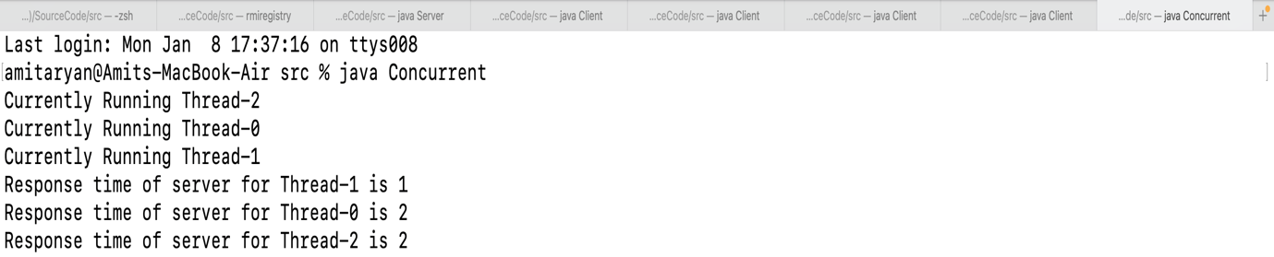
Result and Interpretation
1.Registering the PEER
2.Searching and Downloading for a particular file from the indexing server
3.Concurrently searching the file and downloading the file

Slide 8
Conclusion
In conclusion, the provided code lays the foundation for a distributed file-sharing system, showcasing fundamental concepts of P2P communication, multithreading, and file handling in Java. Further development could enhance security, error handling, and scalability aspects for a robust and production-ready P2P file-sharing solution.

Slide 9
References
[1] Computer Networks, Andrew S. Tannenbaum, Pearson India.
[2] Java Network Programming by Harold, O’Reilly (Shroff Publishers).
[3] https://steemit.com/utopian-io/@lapulga/java-tutorial-how-to-create-peer-to-peernetwork-with-java-programming-on-netbeans
[4] https://github.com/SagarFall2022/AdvancedOperatingSystems

Slide 10


Slide 11


